Slide 1
MyTicketBooking
search
S
Login
Location
Help
Movies
Streams
Contact
MyBookings
Home
Movies
Movie 1
Movie 2
Movie 3

Slide 2
MyTicketBooking
search
S
Login
Location
Movies
Streams
Contact
MyBookings
Help
Home
Login
Username
Password
Login
Don’t have account?
Sign Up

Slide 3
MyTicketBooking
search
S
Login
Location
Home
Movies
Streams
Contact
MyBookings
Help
Sign Up
Name
Email
City
Mobile No
Password
Sign Up
Already have account?
Sign In

Slide 4
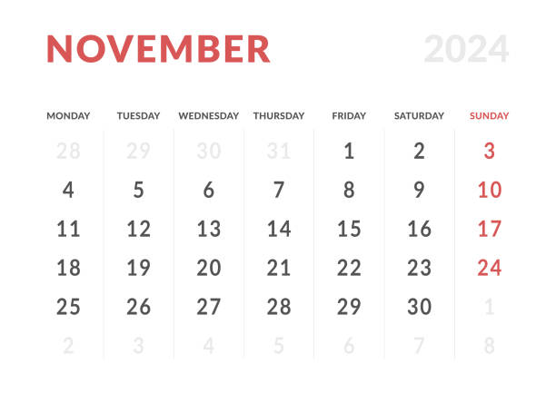
MyTicketBooking
search
S
Login
Location
Help
Movies
Streams
Contact
MyBookings
Home
My Bookings
Download Tickets
Select Date
Booking 1
Booking 2

Slide 5
MyTicketBooking
search
S
Login
Location
Home
Movies
Streams
Contact
MyBookings
Help
Hindi
English
Marathi
Telugu
Tamil
Gujrati
Kannada
Hindi Movies
Filters
Generes
Generes
comedy
Action
Thriller
Family
Movies 1
Movies 2
Crime
Horror

Slide 6
MyTicketBooking
search
S
Login
Location
Home
Movies
Streams
Contact
MyBookings
Help
Hindi
English
Marathi
Telugu
Tamil
Gujrati
Kannada
Streaming Now
Most Popular
Movies 1
Movies 2
Movies 2

Slide 7
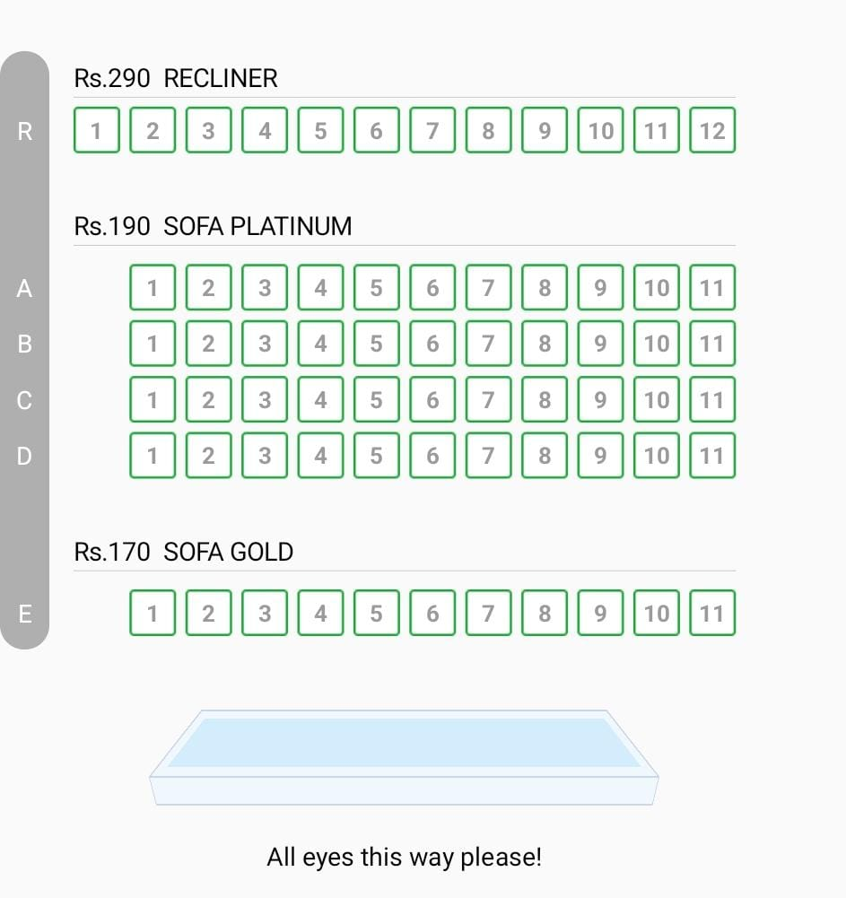

MyTicketBooking
search
S
Login
Location
MyBookings
Help
Movies
Streams
Contact
Home
Movies
Thu, 14 Nov
09:00 AM
12:00 AM
09:00 PM
Confirm Bookings

Slide 8

MyTicketBooking
search
S
Login
Location
Home
Movies
Streams
Contact
MyBookings
Help
Movie Details
A film, also called a movie, motion picture, moving picture, picture, photoplay, or flick—is a work of visual art that simulates experiences and otherwise communicates ideas, stories, perceptions, emotions, or atmosphere through the use of moving images that are generally accompanied by sound and (less commonly) other sensory
Cast
Crew
Book Tickets

Slide 9
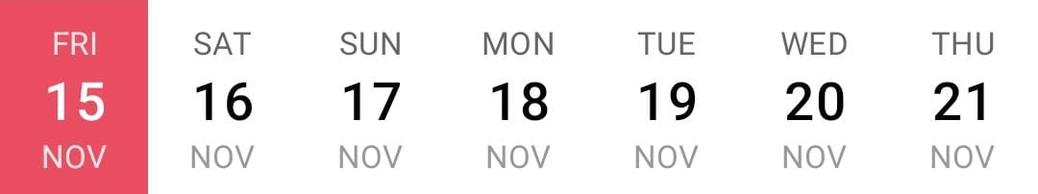
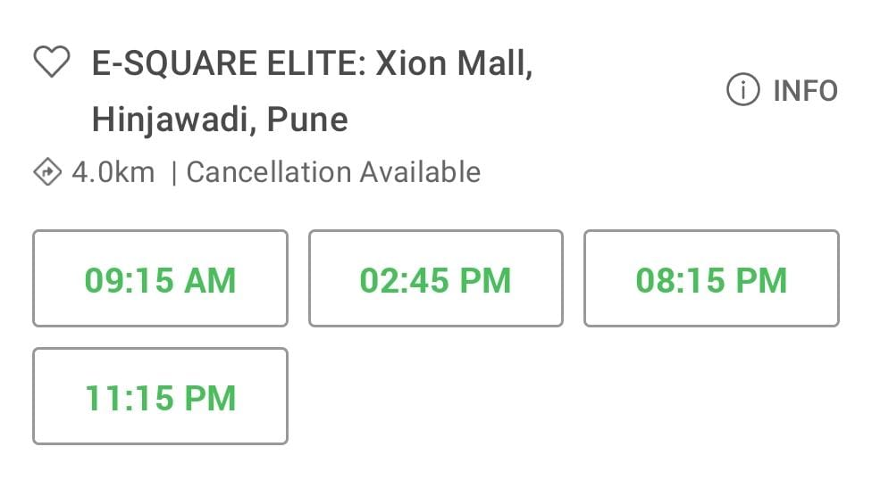
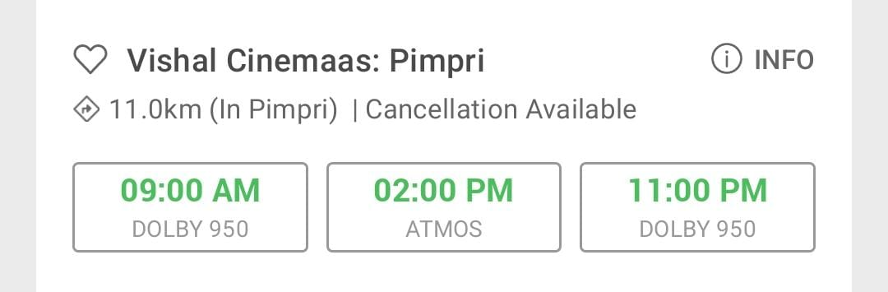
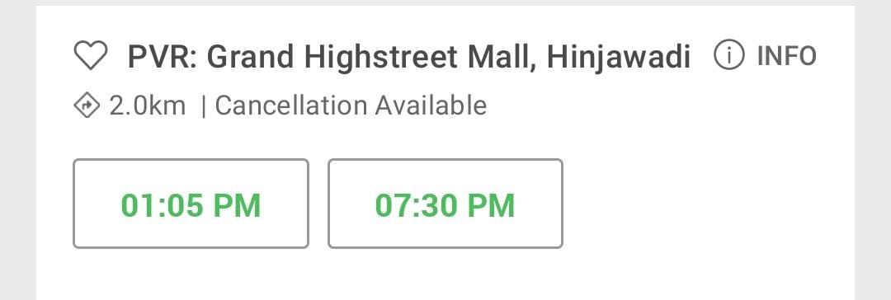
MyTicketBooking
search
S
Login
Location
Home
Movies
Streams
Contact
MyBookings
Help
Available Theatres

Slide 10
MyTicketBooking
search
S
Login
Location
Help
Movies
Streams
Contact
MyBookings
Home
Ticket
Movie Name
Seat Details
Movie Date and Time
Movie Ticket Amount
Cancel Booking
Save Tickets

